Slide 1
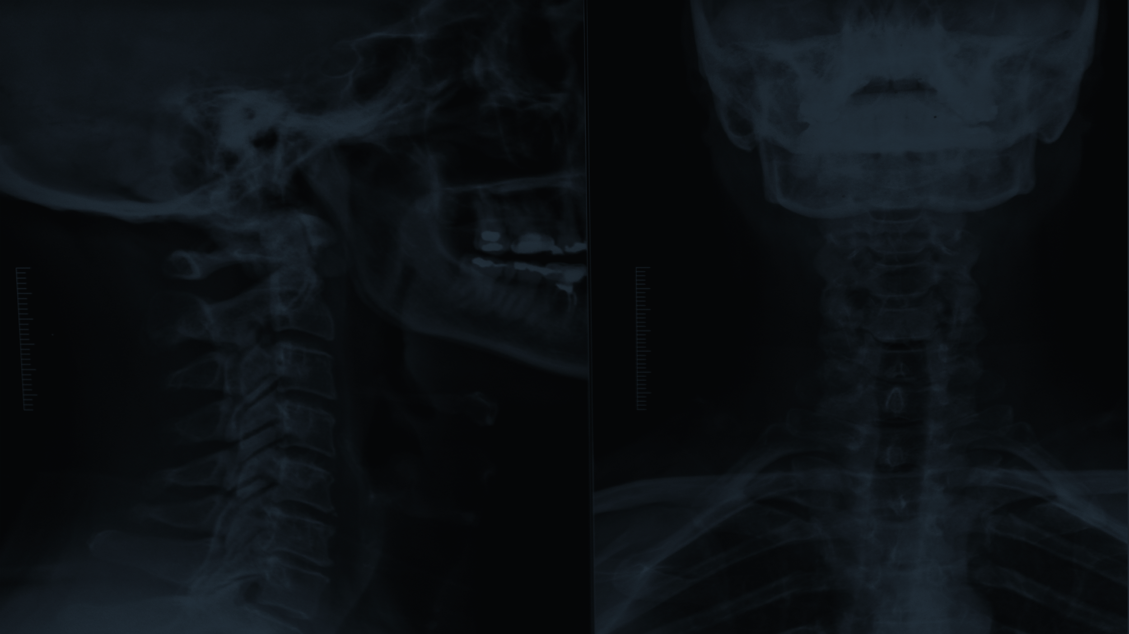
Predicting Bone Age
Exploiting Images Through CNN Models

Slide 2
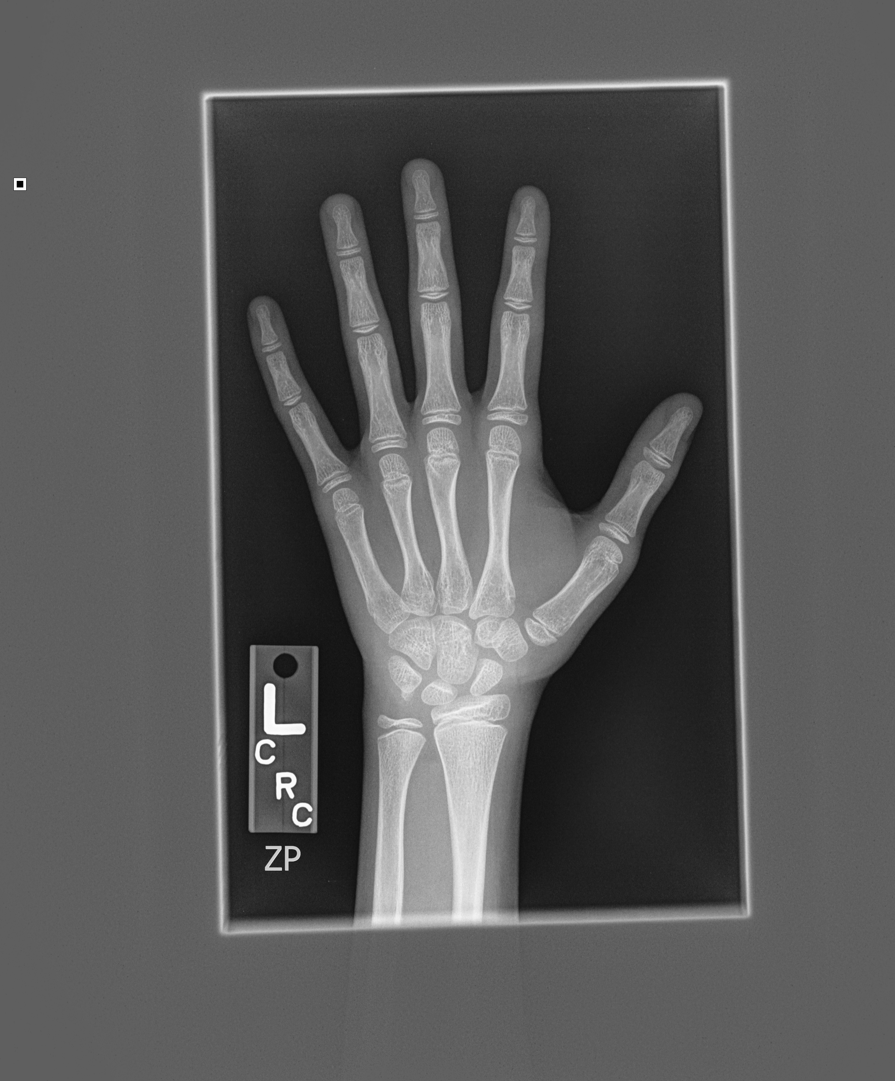
AIM OF STUDY
To create original Neural Network architectures to put into practice the theories thought in the lecture while trying to solve the problem of determining skeletal age of pediatric hand radiographs.

Slide 3
Table of Contents
01
02
03
04
Pipeline
and
Features
Network Architectures
Remarks
Results

Slide 4

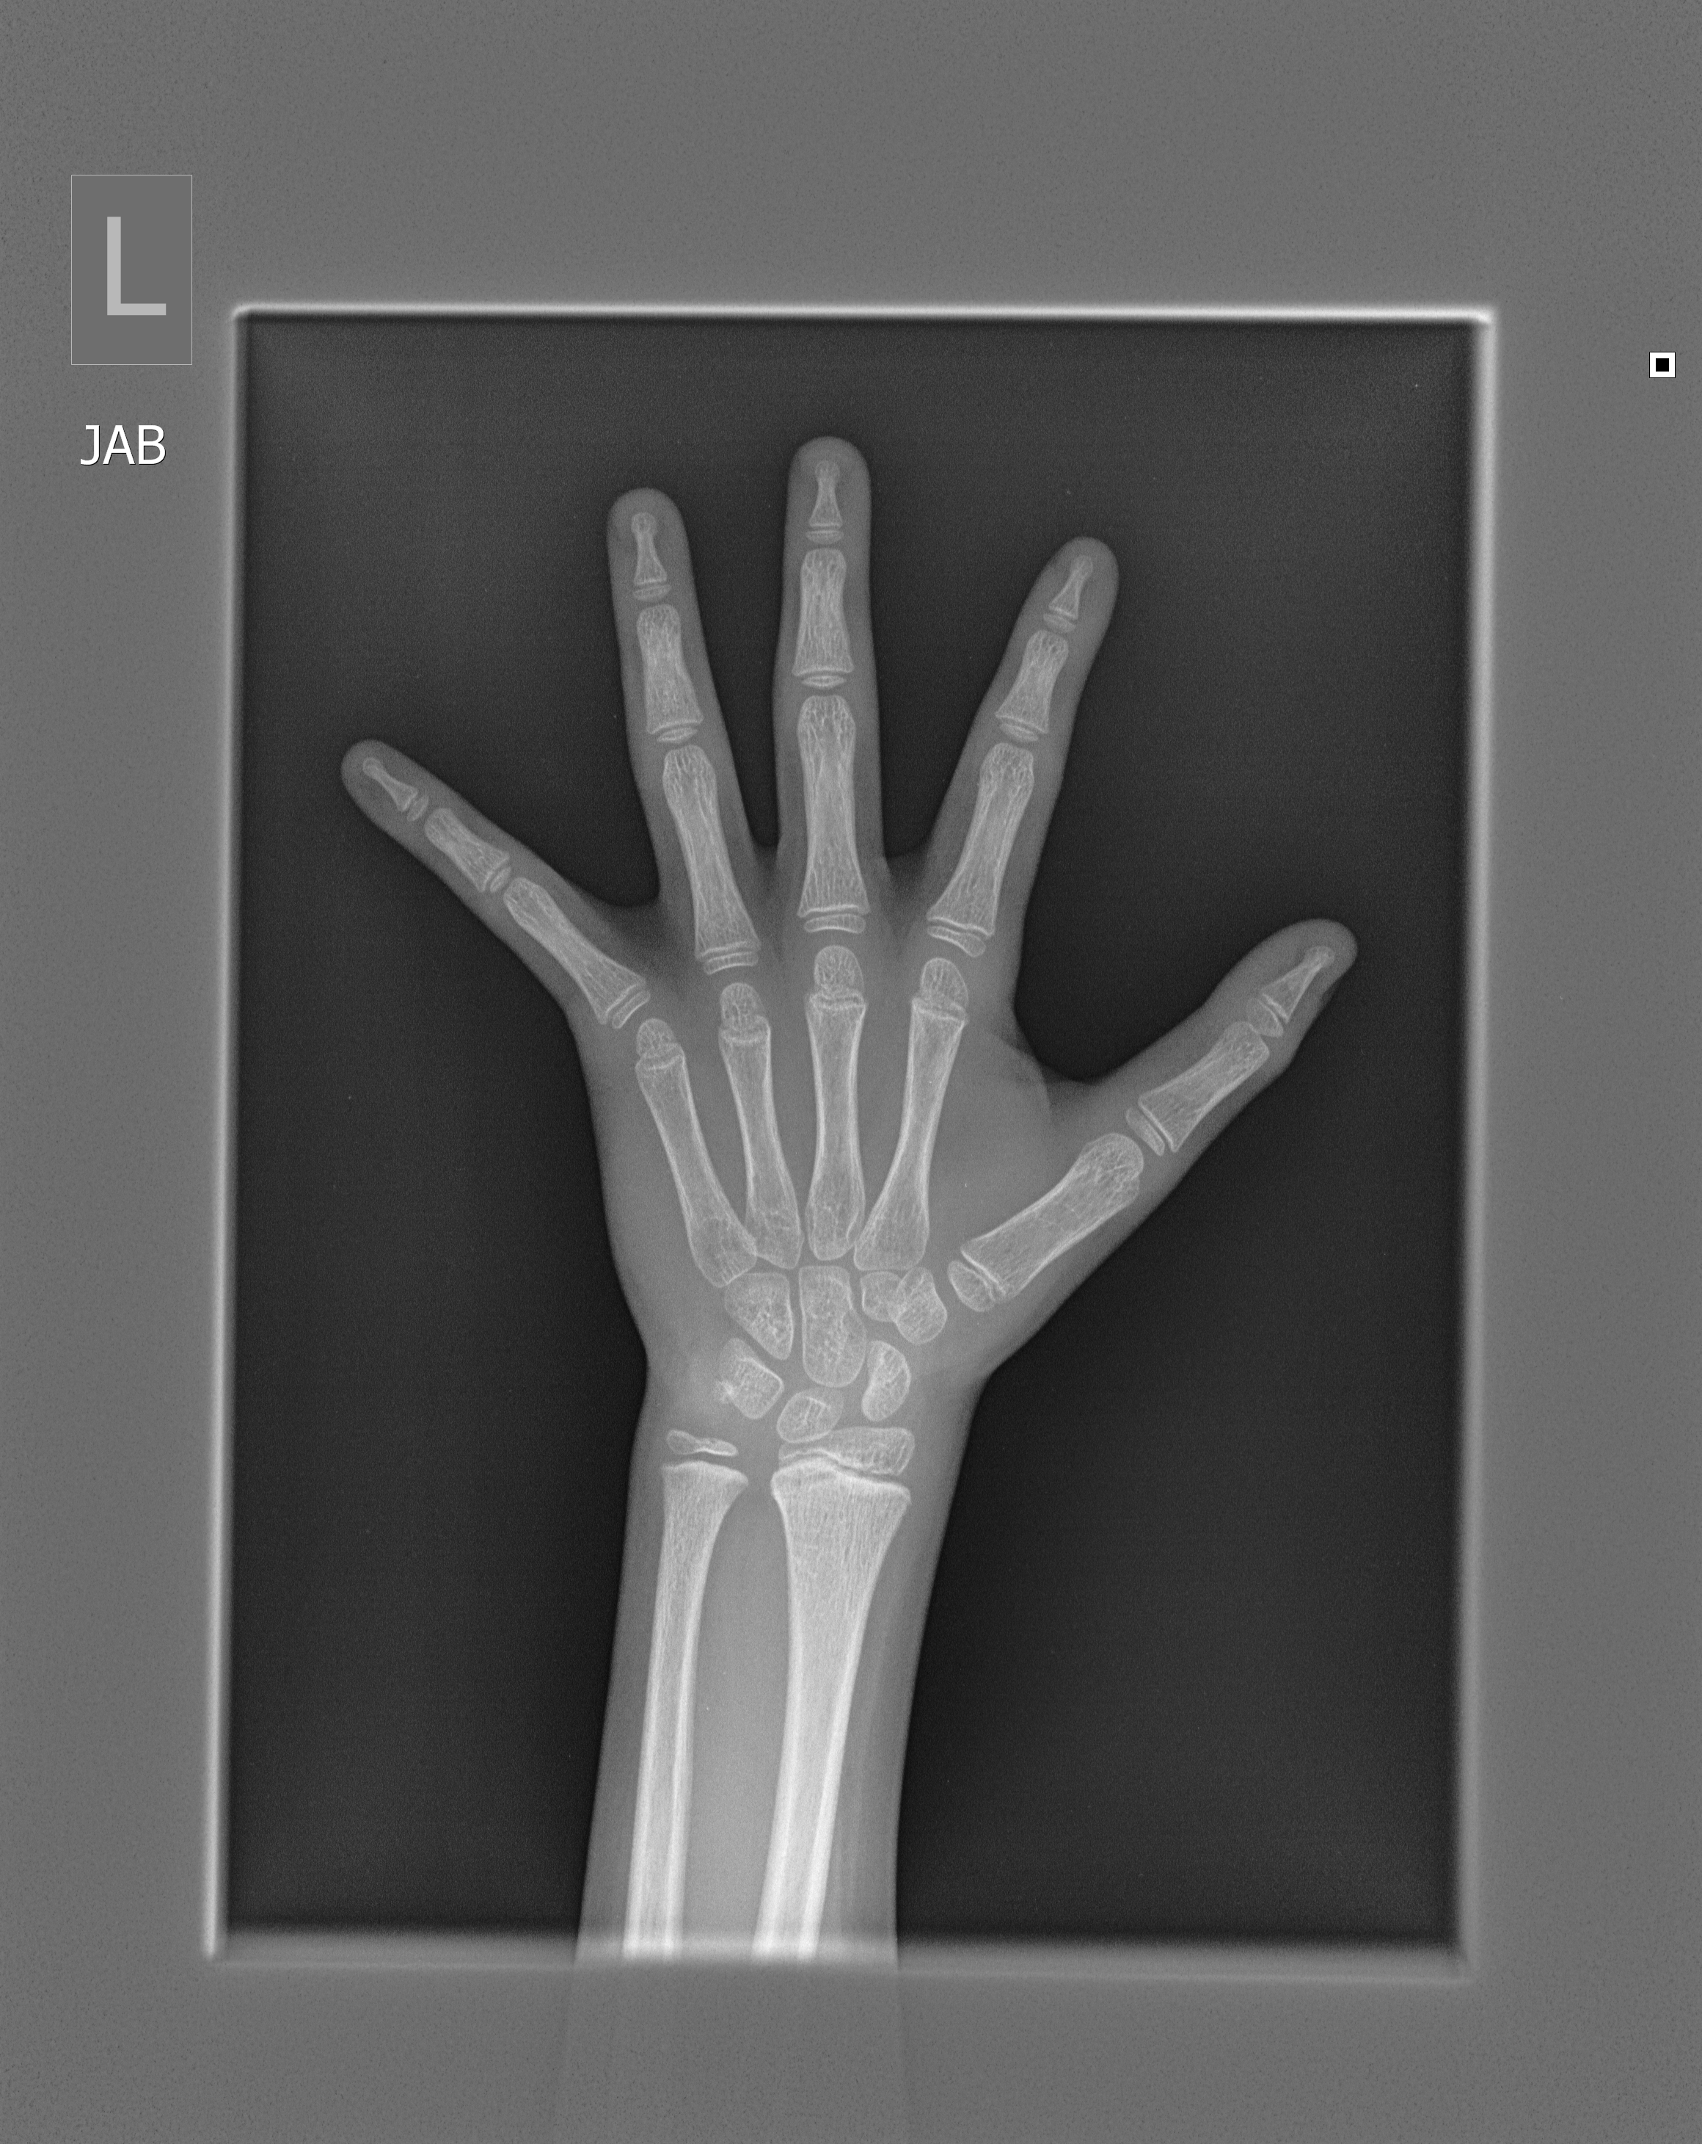
Basic Processing Pipeline

Slide 5
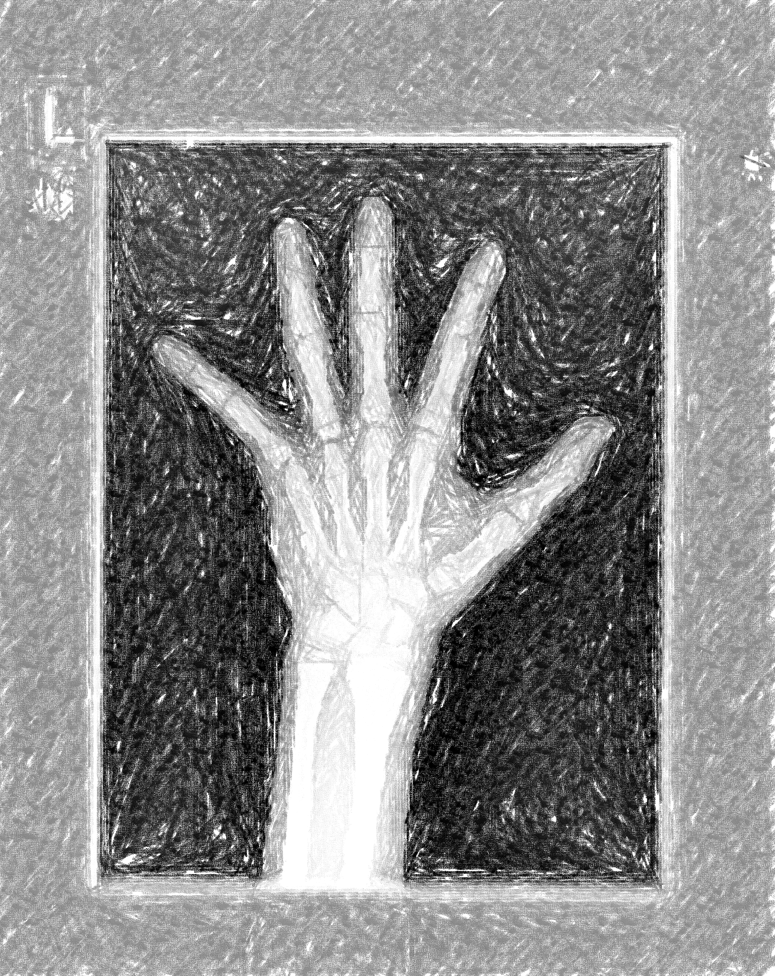
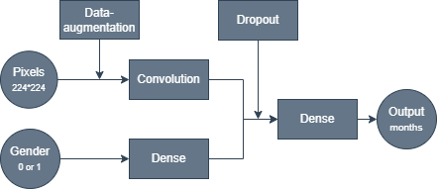
Processing Pipeline - Extras

Slide 6
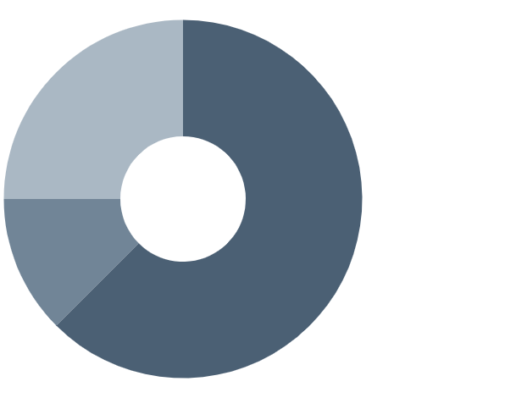
Data
Training: 12611
Validation: 1425
Test: 200

Slide 7
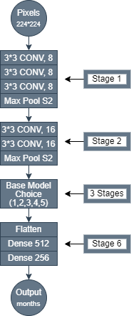
General Network Architecture
Stage 1-2 : VGG Idea stacking 3*3 kernels
Stage 3-4-5 : Choose one of model options (32-64-128 filters 3*3 kernels)
Stage 6: Flatten and Dense Layers

Slide 8

Base Models
model 1: basic convolution
model 2: inception block
model 3: skip connection
model 4: skip connection with pre-activation
model 5: inception block with skip connection

Slide 9
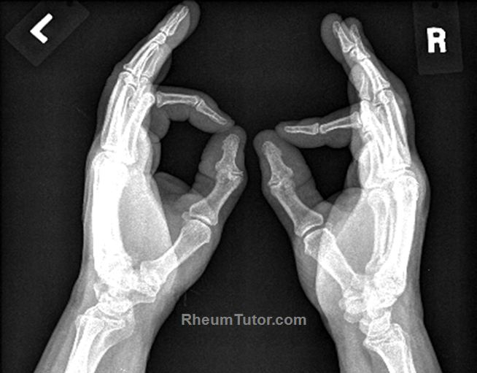
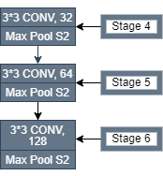
Model 1: Basic Convolution

Slide 10
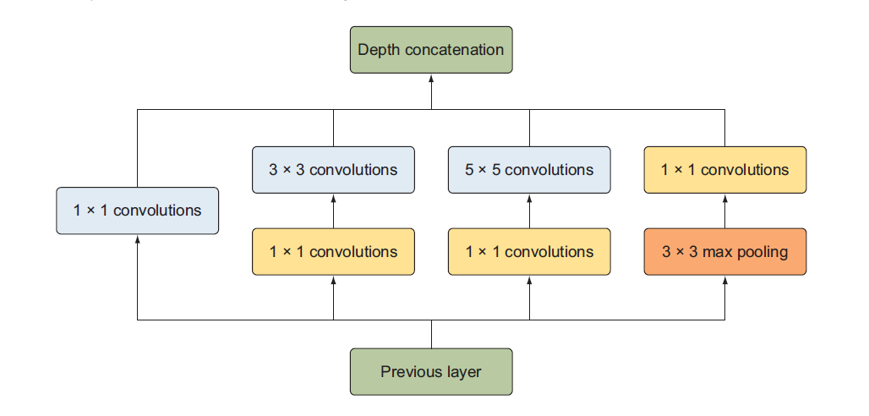
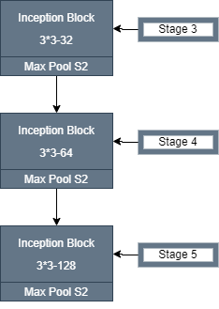
Model 2: Inception Block

Slide 11
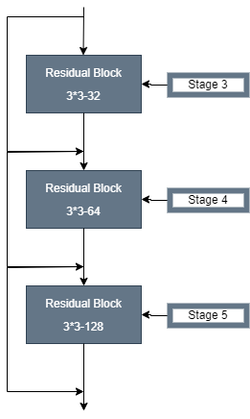
Model 3: Skip Connection
Stride : 2

Slide 12
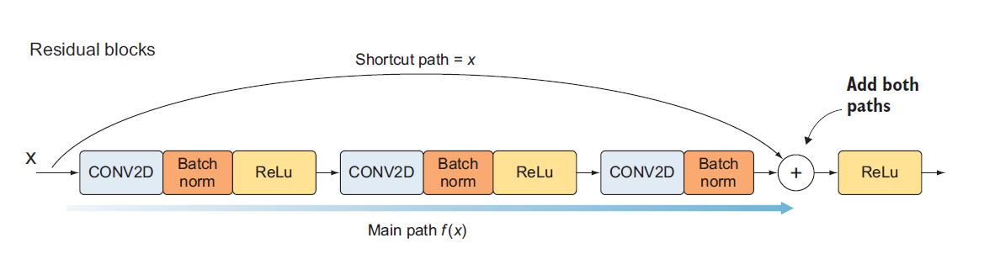
Model 3: Skip Connection

Slide 13
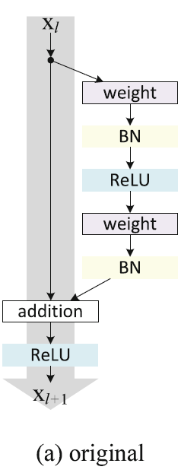
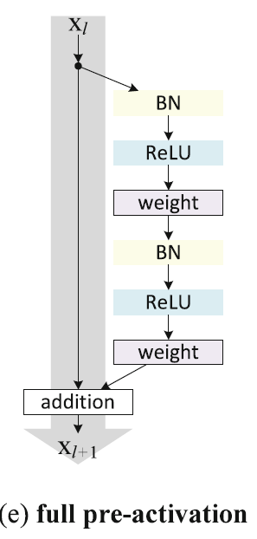
Model 4: Skip Connection with Pre-activation

Slide 14
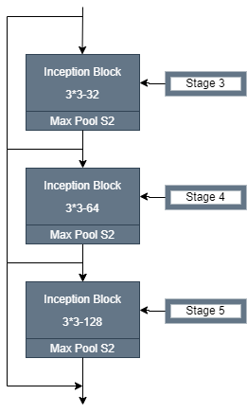
Model 5: Inception Block with Skip Connection

Slide 15



Model Details
Loss Function : MAE
Optimizer : Adam
Learning Rate : {0.1, 0.01, 0.001}
Learning Rate Reduction : 4 epoch Validation Loss Monitoring
Number of Epochs: 50
Early Stopping: 8 epoch Validation Loss Monitoring
Batch Size: 64
Implementation Phase: PyCharm, Tensorflow, Excel, GitHub, ChatGPT

Slide 16
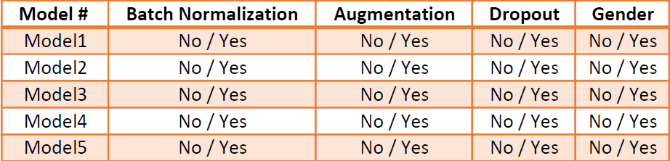
Hyperparameters

Slide 17
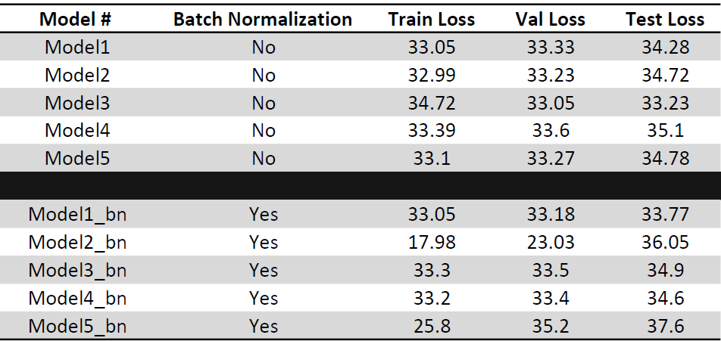
Results / Batch-Normalization

Slide 18
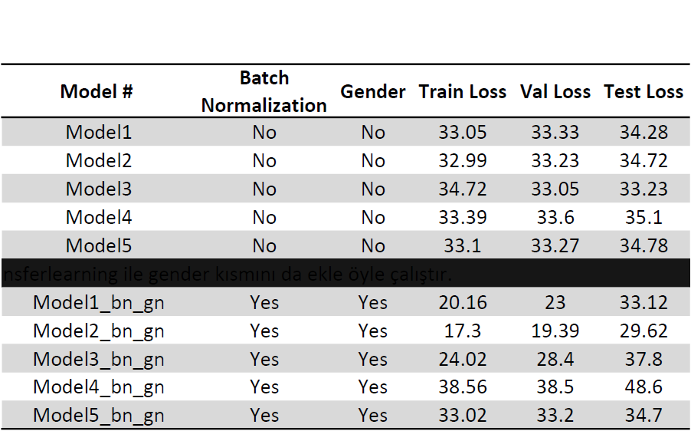
Results – Gender Information

Slide 19
Epochs vs Training Loss
Model # | Parameters
Model1 | 3.5
Model2 | 5.9
Model3 | 3.5
Model4 | 3.5
Model5 | 5.9

Slide 20
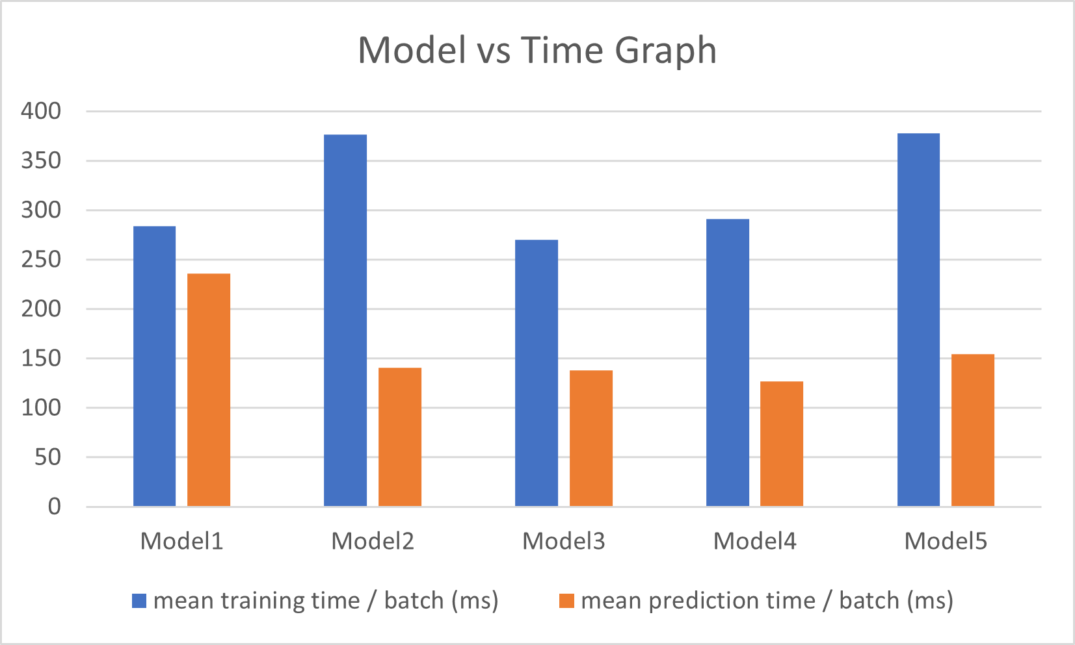
Training and Prediction Time
Model # | Parameters
Model1 | 3.5
Model2 | 5.9
Model3 | 3.5
Model4 | 3.5
Model5 | 5.9

Slide 21
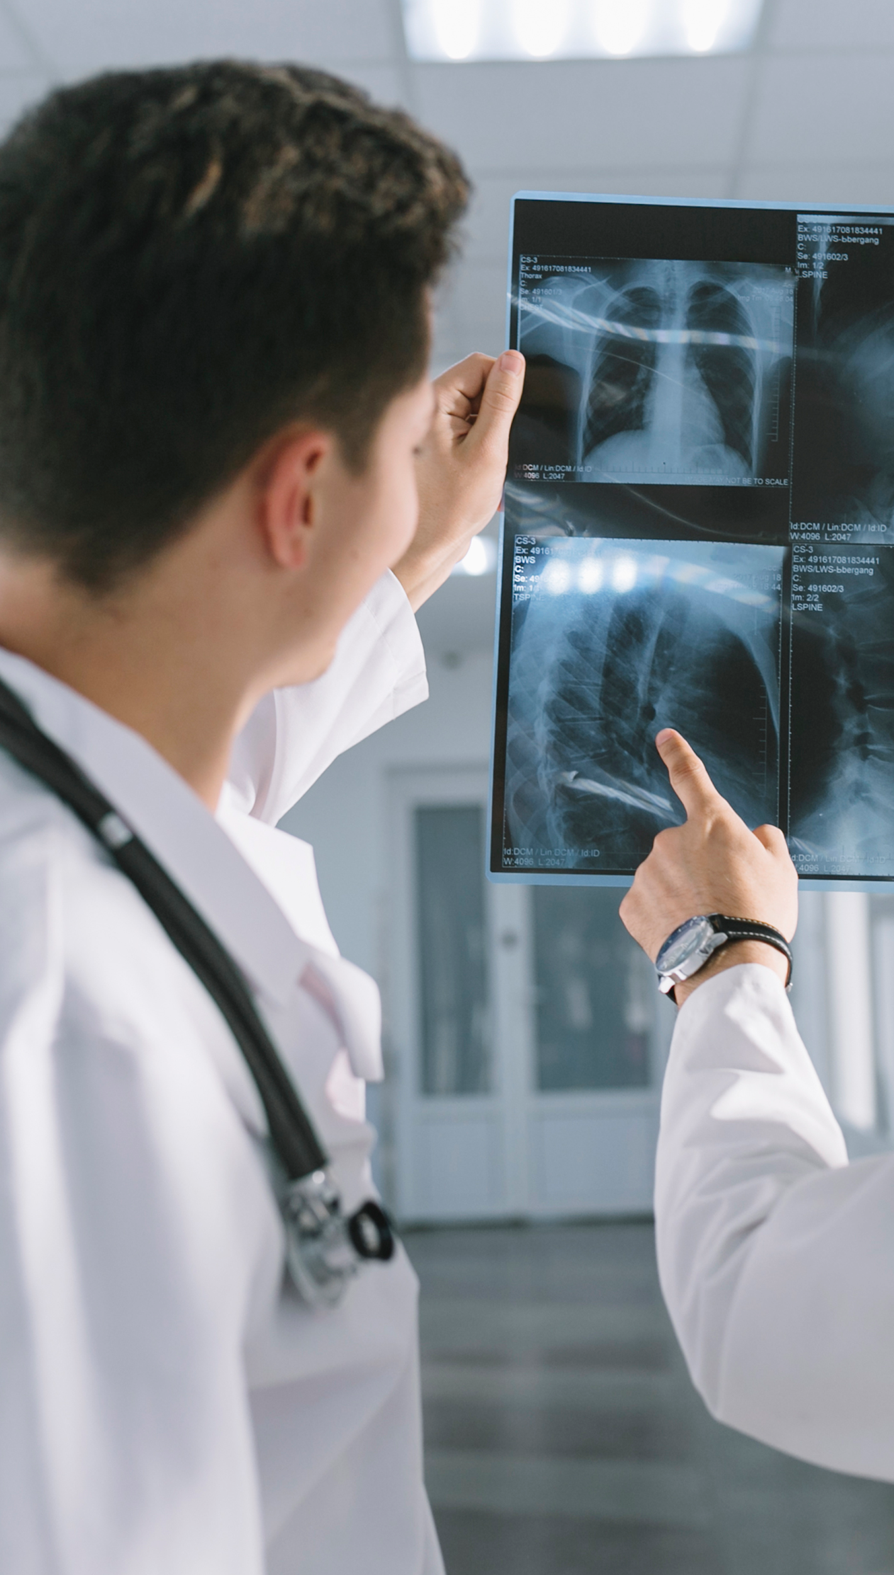
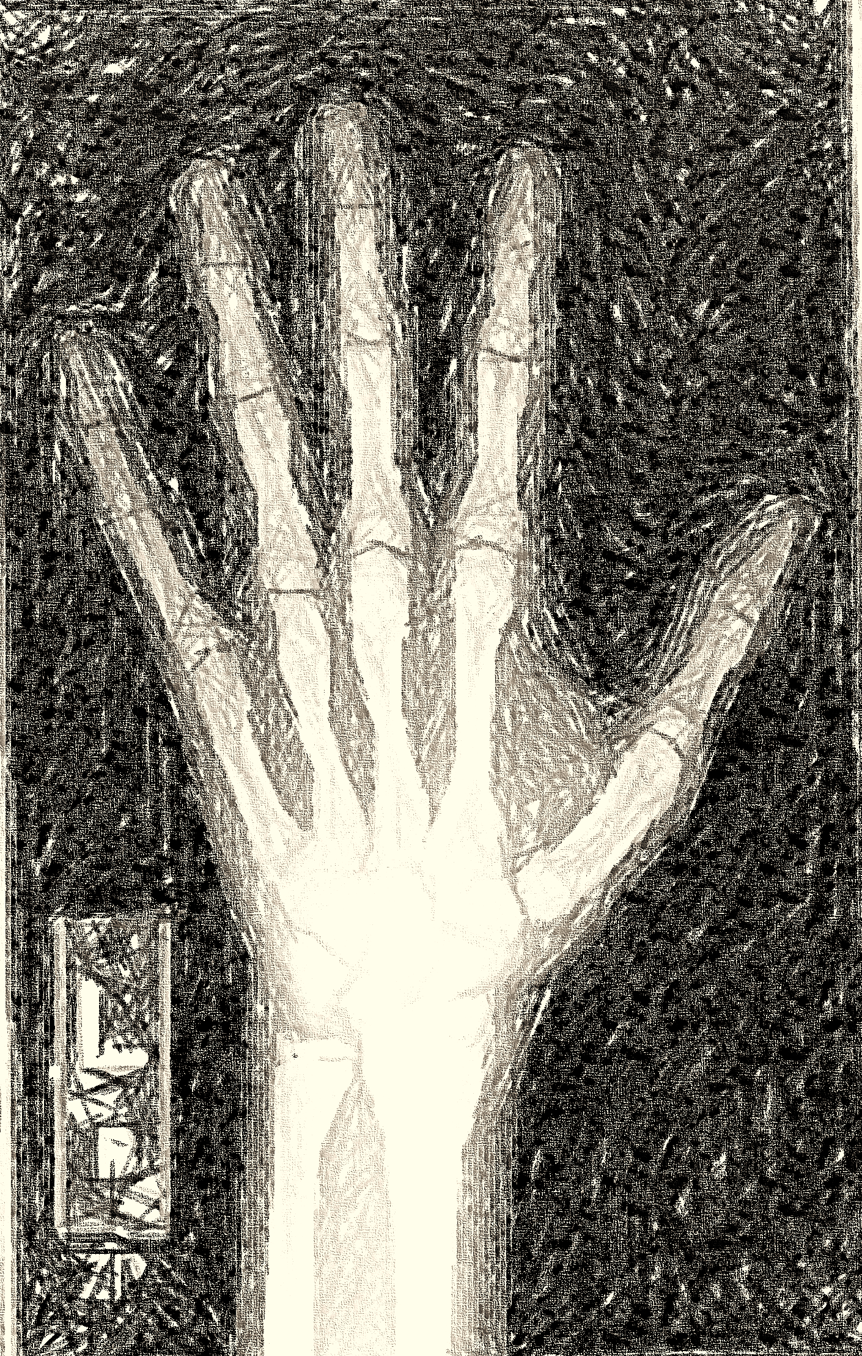
Remarks
Experiment Design
CNN Models
Usage of IDE and Versioning System
Memory Allocation
Transfer Learning
Validation Set

Slide 22
Thanks
Süleyman Erim
UniPd DataScience
Sueleyman.erim@studenti.unipd.it
Do you have any questions?

